Slide 1

#LifeKoKaroLift
Post-Graduate Diploma in ML/AI

Slide 2


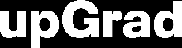
Course : Machine Learning
Lecture On : RL
Instructor : Manish Kumar

Slide 3

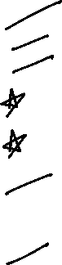
Session - Agenda
What is Reinforcement Learning
Markov State
Model Based & Model Free methods
RL Equations:
State value & Action Value Functions
Model Based methods
Policy Iteration and Value Iteration
Model Free methods
Monte-carlo methods
Q-Learning
Deep Q-learning

Slide 4
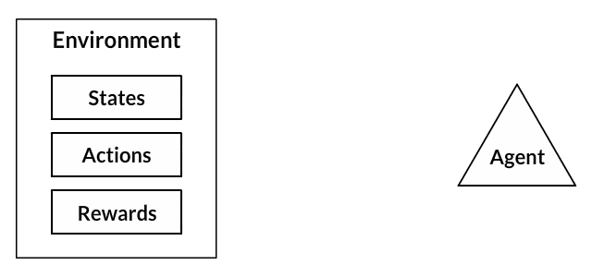
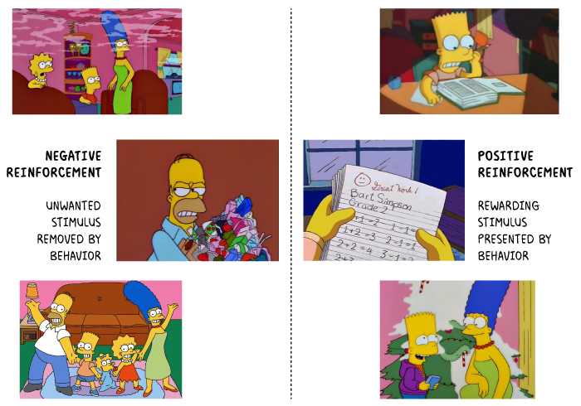
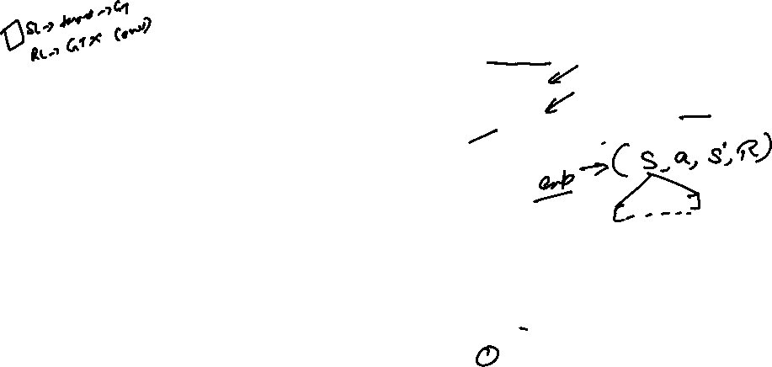
Reinforcement Learning
“ Reinforcement learning is the training of machine learning models to make a optimal decisions using experiences ”
Learning Steps :
Observation of the environment
Deciding how to act using some strategy
Acting accordingly
Receiving a reward or penalty
Learning from the experiences and refining our strategy
Iterate until an optimal strategy is found

Slide 5
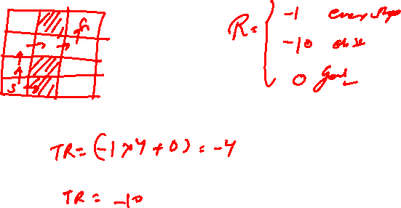

Slide 6
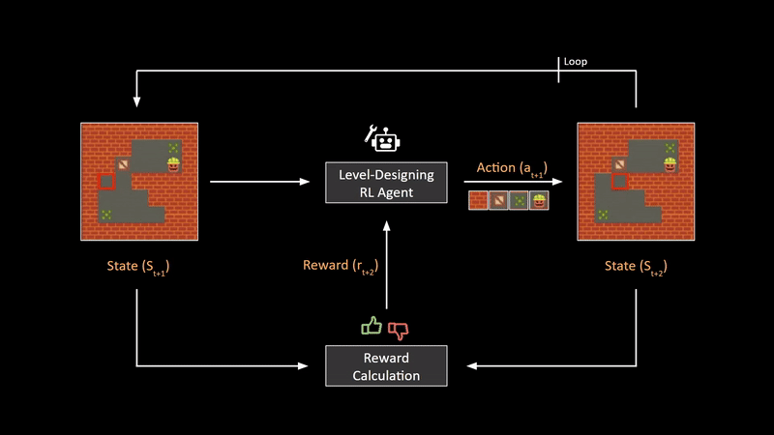

Slide 7
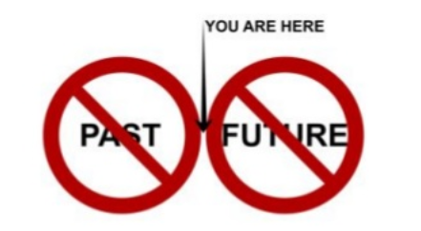
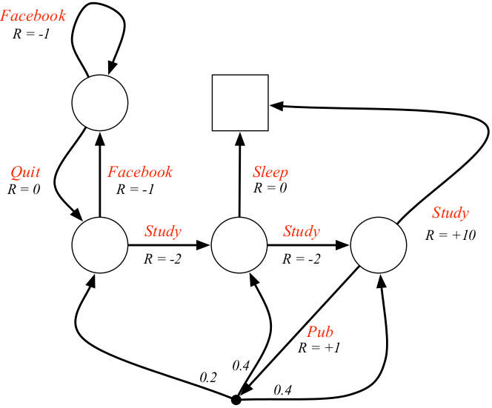
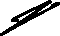
Markov State
“ The Markov assumption assumes that the current state is sufficient for taking the next action. So, Markov state has all relevant information to model the problem. The process which follows Markov property is called Markov Decision Processes (popularly called MDPs) “

Slide 8



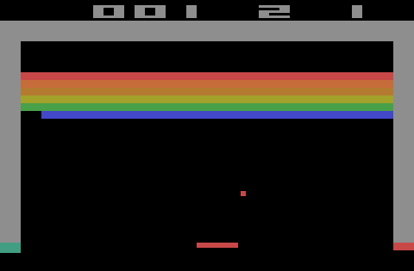
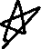

Poll 1
What could be the state vector for a Atari Breakout game ? (Multiple Correct)
A) Ball Coordinates
B) Ball Velocity
C) Paddle Position
D) Coordinates of remaining bricks
Practice in teams of 4 students
Industry expert mentoring to learn better
Get personalised feedback for improvements
27-03-2022
11

Slide 9
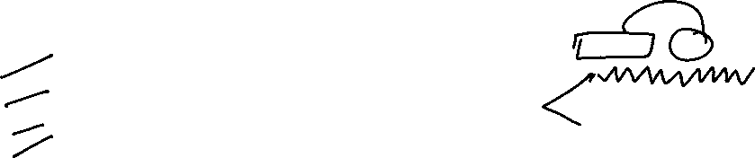
Poll 1 (Solution)
What could be the state vector for a Atari Breakout game ?
A) Ball Coordinates
B) Ball Velocity
C) Paddle Position
D) Coordinates of remaining bricks
Practice in teams of 4 students
Industry expert mentoring to learn better
Get personalised feedback for improvements
27-03-2022
11

Slide 10
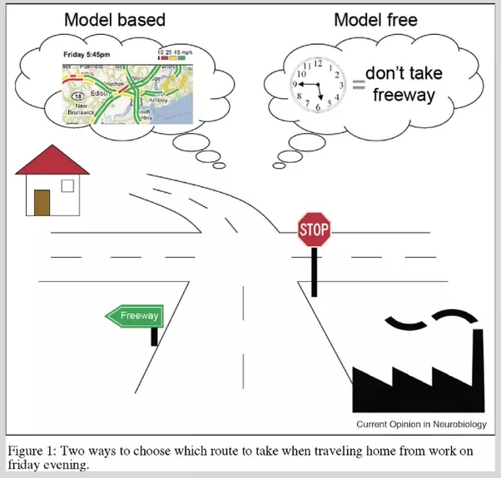
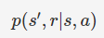
Model Vs Model Free Environment
The model of an environment is represented as:
It is the probabilistic distribution of finding the agent in state s and reaping the reward r, given a particular action a is taken in a particular state s. This is known as the model of the environment.
model-based methods, it is possible to learn what is called a model of the environment, i.e. a model which maps the consequences (next state, reward) of taking an action in a state.
model-free methods, it is not possible to learn an explicit model (which is a more realistic case).
https://www.princeton.edu/~yael/Publications/DayanNiv2008.pdf

Slide 11
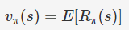
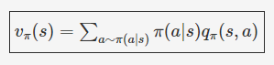
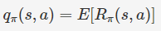
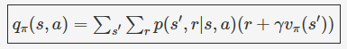
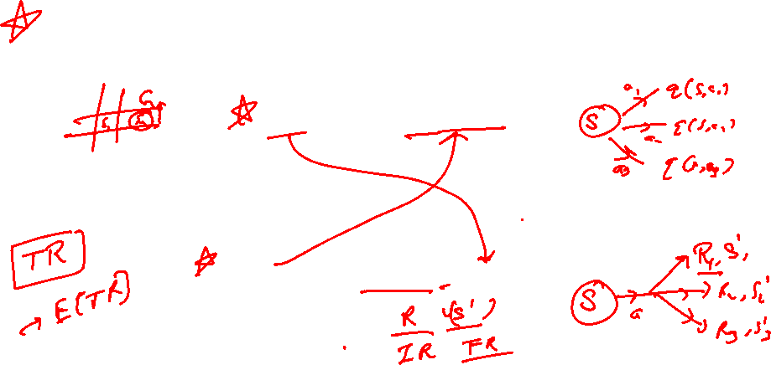
RL - Equations
“ The state-value function V𝜋(s) of an MDP is the expected return starting from state S, and then following policy 𝜋 ”
“ The action-value function q𝜋(s, a) is the expected return starting from state s, taking action a, and following policy 𝜋 ”

Slide 12
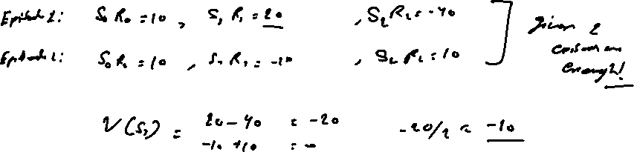

Slide 13
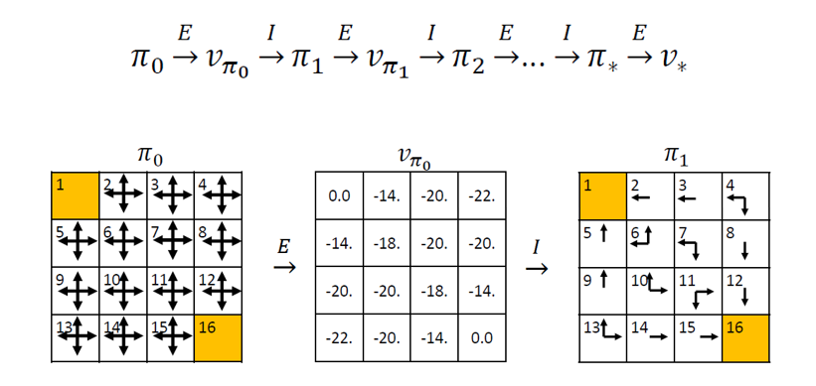
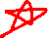
Model-Based Method
Policy Iteration: Policy Evaluation + Policy Improvement
Policy Evaluation: Find out how good a policy is?
Evaluate the policy π by calculating the state value functions vπ(s). Calculate the state-values until convergence.
Policy Improvement: Improve an arbitrary policy
Improve the policy by choosing the action with maximum state-action value qπ(s,a) in each state.

Slide 14
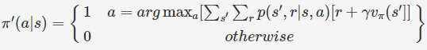
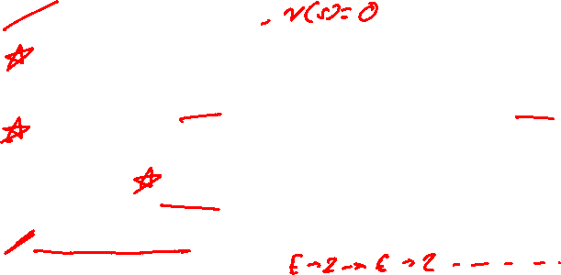
Model-Based Method
Policy Iteration: Policy Evaluation + Policy Improvement
STEPS
initialize a policy π randomly
Evaluate the policy
Evaluate the policy until the state-values are not converged for the policy π
Improve the policy
The action with the maximum state-action value qπ(s,a) is the best action. The improved policy π′ is
Repeat till convergence

Slide 15
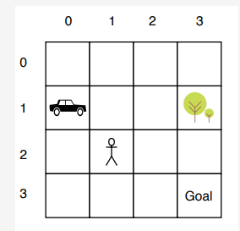
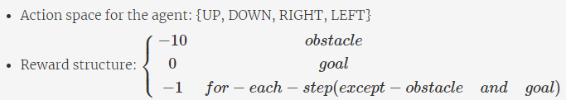
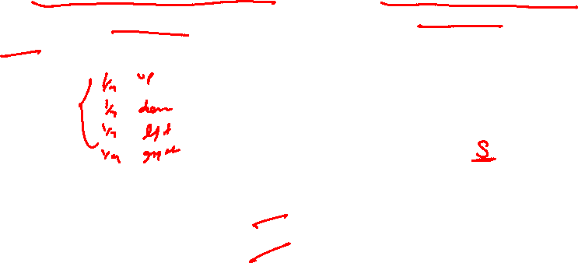
Poll
Assume an probabilistic policy was initialized where each action is equally probable and with initial value V(s) being 0 , calculate the new value for Vπ(s=(2, 3)) , Assume γ=1
A) -10/4
B) -3
C) -5/2
D) 3
Practice in teams of 4 students
Industry expert mentoring to learn better
Get personalised feedback for improvements
27-03-2022
11

Slide 16
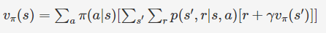
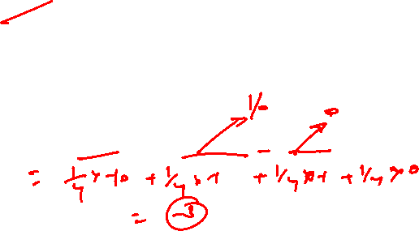
Poll (Solution)
Assume an probabilistic policy was initialized where each action is equally probable and with initial value V(s) being 0 , calculate the new value for Vπ(s=(2, 3)) , Assume γ=1
A) -10/4
B) -3
C) -5/2
D) 3
Practice in teams of 4 students
Industry expert mentoring to learn better
Get personalised feedback for improvements
27-03-2022
11

Slide 17
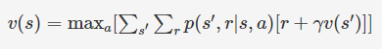
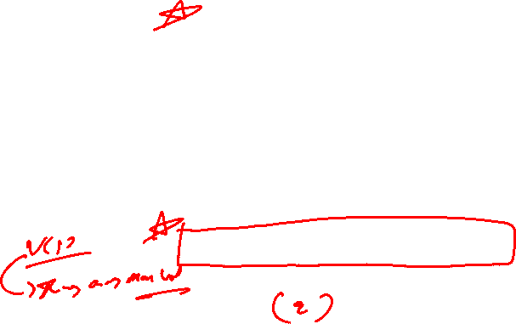
Model-Based Method
Value Iteration
In value iteration, instead of running the policy evaluation step till the state-values converge, you perform exactly one update, calculating the state-values. These state-values are corresponding to the action that yields the maximum state-action value. The state-value function is a greedy choice among all the current actions:

Slide 18
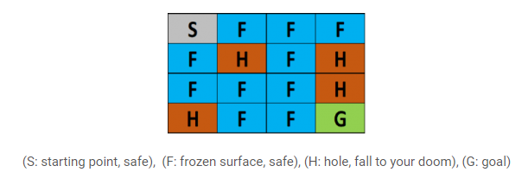
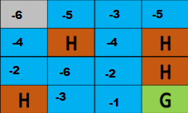
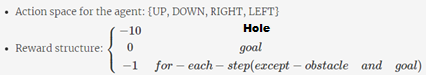
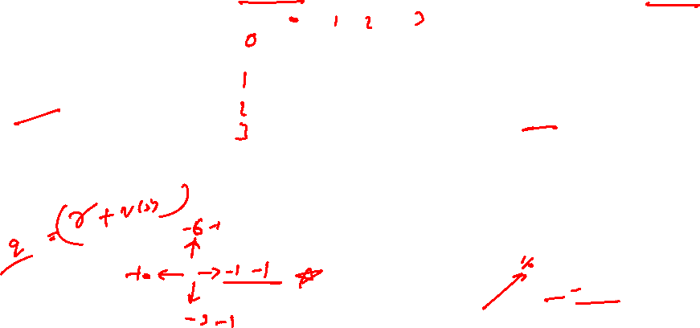
Poll
Calculate the new value of s = (3,1), using the Value Iteration equation. Assume γ=1
A) -3
B) -2
C) -1
D) -7
Practice in teams of 4 students
Industry expert mentoring to learn better
Get personalised feedback for improvements
27-03-2022
11

Slide 19
Poll (Solution)
Calculate the new value of s = (3,1), using the Value Iteration equation. Assume γ=1
A) -3
B) -2
C) -1
D) -7
Practice in teams of 4 students
Industry expert mentoring to learn better
Get personalised feedback for improvements
27-03-2022
11

Slide 20
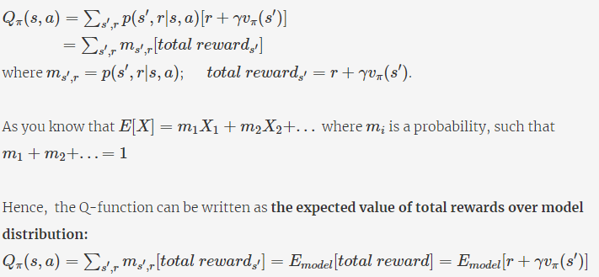
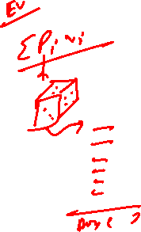
Model-Free Method
The equations can be solved if the model of the environment p(s′,r|s,a) is available. In most real-life scenarios with large state and action spaces, the model of the environment is not available (i.e. model-free methods). In such cases, you can compute the q-function using the fact that it is the expected value of the total reward

Slide 21
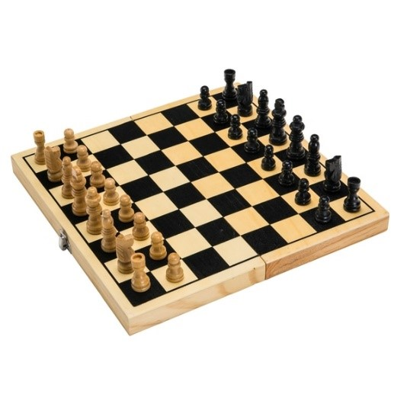
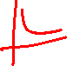
Monte-Carlo Method
The Monte Carlo method for reinforcement learning learns directly from episodes of experience without any prior knowledge of MDP transitions. Here, the random component is the return or reward.
One caveat is that it can only be applied to episodic MDPs. The reason is that the episode has to terminate before we can calculate any returns.
It uses the simplest idea – the value is the mean return of all sample trajectories for each state.
The most important thing to ensure is that, while following the policy π, each state-action pair should be visited enough number of times to get a true estimate of qπ(s,a). For this, you need to keep a condition known as the exploring starts. It states that every state-action pair should have a non-zero probability of being the starting pair.
That’s why we follow an off-policy approach
https://medium.com/ai%C2%B3-theory-practice-business/reinforcement-learning-part-5-monte-carlo-and-temporal-difference-learning-889053aba07d

Slide 22
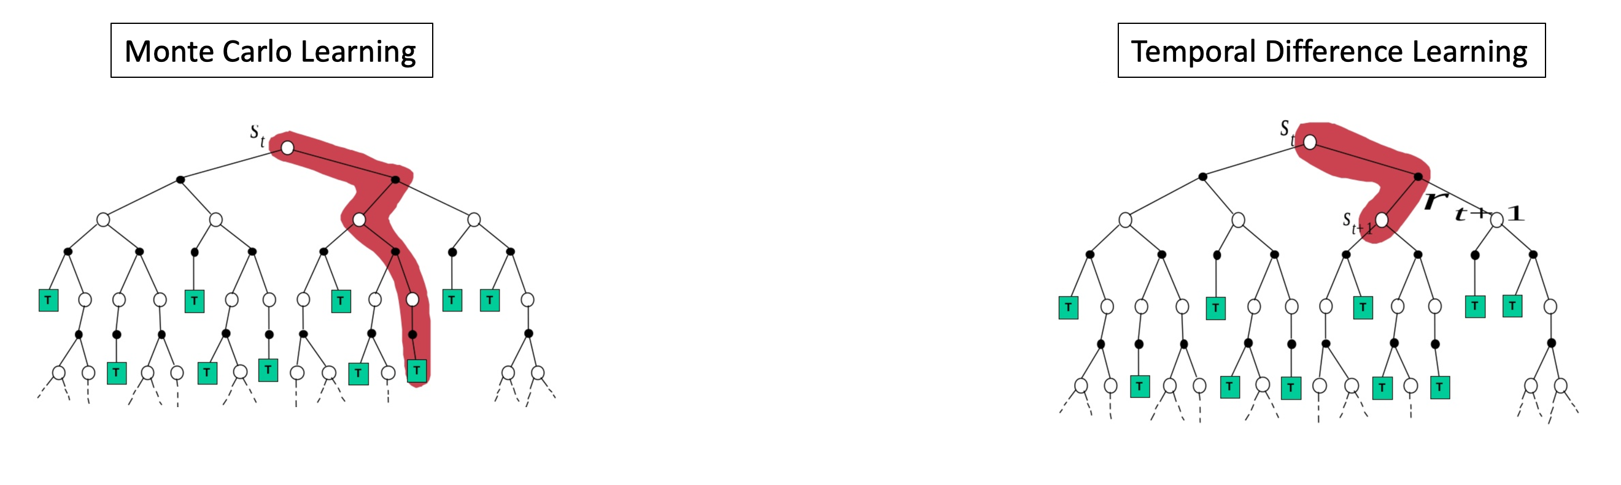
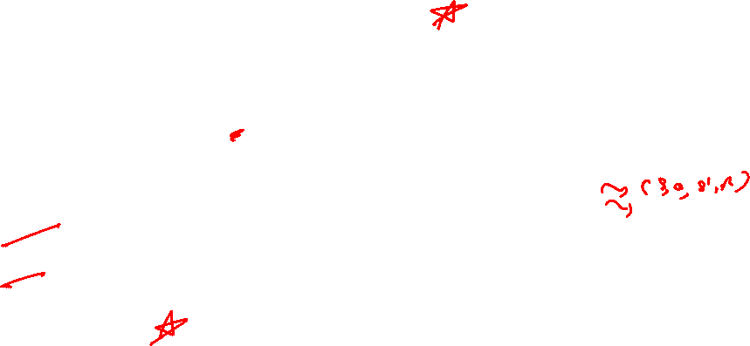
Temporal Difference
Similar to Monte-Carlo, Temporal Difference (TD) methods also learn directly from experience without an explicit model of the environment.
The major difference between these two methods is:
In Monte Carlo methods, you need to wait until the end of the episode and then update the q-value
In TD methods, you can update the value after every few time steps. This update mechanism is often advantageous since it gives the agent early signals if some of the eventual states are disastrous, and so the agent avoids that path altogether.

Slide 24
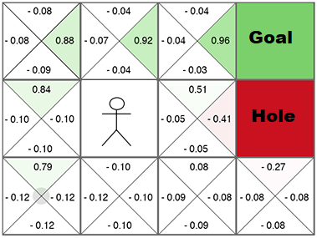
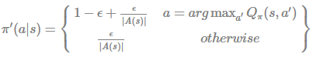
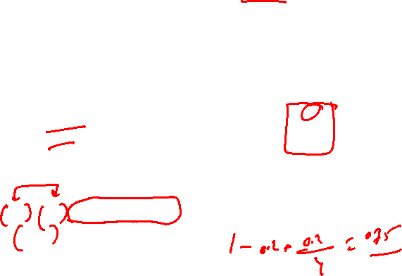
Poll
What is the improved policy at (2,0)? Assume ϵ=0.2
A) π′(a|s) =
0.85 a=Right
0.05 Left,Up,Down
B) π′(a|s) =
0.85 a=UP
0.05 Left,Up,Down
C) π′(a|s) =
0.75 a=UP
0.05 Left,Up,Down
Practice in teams of 4 students
Industry expert mentoring to learn better
Get personalised feedback for improvements
27-03-2022
11

Slide 25
Poll (Solution)
What is the improved policy at (2,0)? Assume ϵ=0.2
A) π′(a|s) =
0.85 a=Right
0.05 Left,Up,Down
B) π′(a|s) =
0.85 a=UP
0.05 Left,Up,Down
C) π′(a|s) =
0.75 a=UP
0.05 Left,Up,Down
Use the following eqn
Practice in teams of 4 students
Industry expert mentoring to learn better
Get personalised feedback for improvements
27-03-2022
11

Slide 26
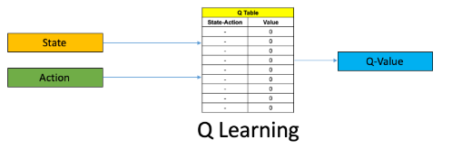
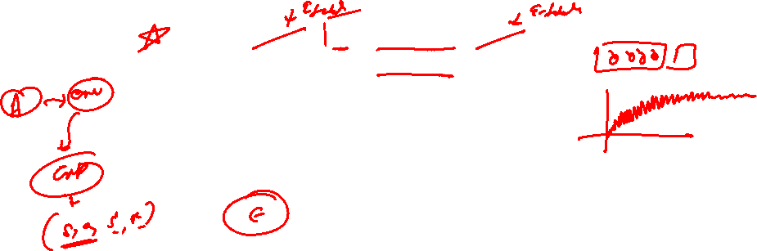
Q-Learning
In Q-learning, you do max-update. After taking action a from state s, you get an immediate reward of r and land in a new state s′. From s′, you take the most greedy action, i.e., the action with the highest q-value.

Slide 27
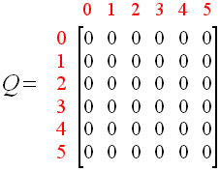
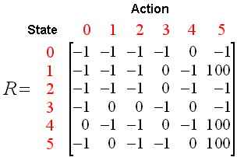
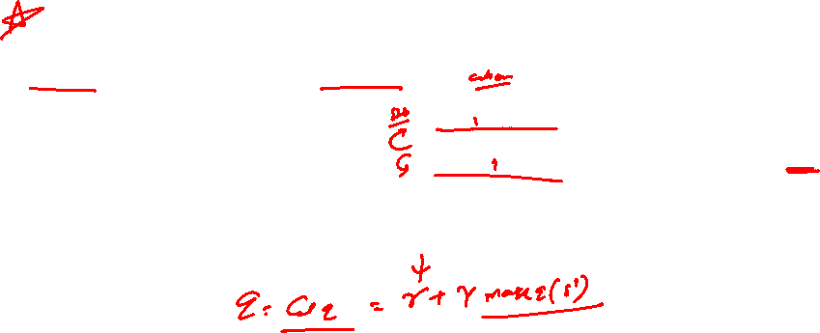
Poll
Given the previous Q and values and the Reward matrix R calculate the updated Q(1,5) given Gamma=0.8 and alpha =1
A) 100
B) 80
C) 0
D) -1
Practice in teams of 4 students
Industry expert mentoring to learn better
Get personalised feedback for improvements
27-03-2022
11

Slide 28
Poll (Solution)
Given the previous Q and values and the Reward matrix R calculate the updated Q(1,5) given Gamma=0.8 and alpha =1
A) 100
B) 80
C) 0
D) -1
Practice in teams of 4 students
Industry expert mentoring to learn better
Get personalised feedback for improvements
27-03-2022
11

Slide 29

Why Deep Q - Learning
Q-learning is a simple yet quite powerful algorithm to create a good agent. This helps the agent figure out exactly which action to perform.
But what if this Q-table is too long? Things will quickly get out of control!
And what about the new states?
This presents two problems:
First, the amount of memory required to save and update that table would increase as the number of states increases
Second, the amount of time required to explore each state to create the required Q-table would be unrealistic
So, what if we approximate these Q-values with machine learning models such as a neural network? Well, this was the idea behind DeepMind’s algorithm ☺

Slide 30


Challenges in Deep RL
The target is continuously changing with each iteration.
We often depend on the policy or value functions in reinforcement learning to sample actions. However, this is frequently changing as we continuously learn what to explore. As we play out the game, we get to know more about the ground truth values of states and actions and hence, the output is also changing.

Slide 31

Poll
Suppose the probability of taking an action as 0.1 in the current state. Which action did you take in the 'current state’?
S = [0, 6, 13, 2] Epsilon = 0.2
The Q-values for the next state for the 3 possible actions are [30, 60, 50]
( A ) 1
( B ) 2
( C ) 3
( D ) Any of the above
Practice in teams of 4 students
Industry expert mentoring to learn better
Get personalised feedback for improvements
27-03-2022
11

Slide 32
Poll (Solution)
Suppose the probability of taking an action as 0.1 in the current state. Which action did you take in the 'current state’?
S = [0, 6, 13, 2] Epsilon = 0.2
The Q-values for the next state for the 3 possible actions are [30, 60, 50]
( A ) 1
( B ) 2
( C ) 3
( D ) Any of the above
Practice in teams of 4 students
Industry expert mentoring to learn better
Get personalised feedback for improvements
Since the prob 0.1 is lesser than the value of ε=0.2, we will take random action.
27-03-2022
11

Slide 33



Q-learning pseudocode

Slide 34


Architectures of Deep Q Learning: Architecture 1
Disadvantage:
Suppose the state is represented by a vector of size 4 and for every possible state, there can be 2 actions. To find 𝑚𝑎𝑥𝑎𝑄(𝑠 ′ , 𝑎), you have to do feedforward 2 times, one for each action and find the Q-value. Then take the action for which Q-value is the maximum.

Slide 35


Architectures of Deep Q Learning: Architecture 2
Advantage:
The advantage here is that, just by giving state as the input to the NN, you will get Q(s, a) for each action, so you have to run the NN just once for every state. Take the action for which Q(s, a) is the maximum.

Slide 36
#LifeKoKaroLift
Thank You!

